Slide 1
Post Seismic Bridge Inspection
Girders

Slide 2
10 Steps of Assessment
Check Approaches
Check Rails
Check Expansion Joints
Check Wingwalls
Check Abutments
Check Bearings
Check Girders
Check Soffit and Deck
Check Bents or Columns
Check Bent Caps

Slide 3
Seventh and Eighth Parts Girders and Soffit
Check Approaches
Check Rails
Check Expansion Joints
Check Wingwalls
Check Abutments
Check Bearings
Check Girders
Check Soffit
Check Bents or Columns
Check Bent Caps

Slide 4
7. Girders
X
2.
1.
2.
3.
4.
5.
6.
7.
7. Girders
Concrete - spalls/cracks Steel - deflection/chipped paint
Timber - cracked/crushed members

Slide 5
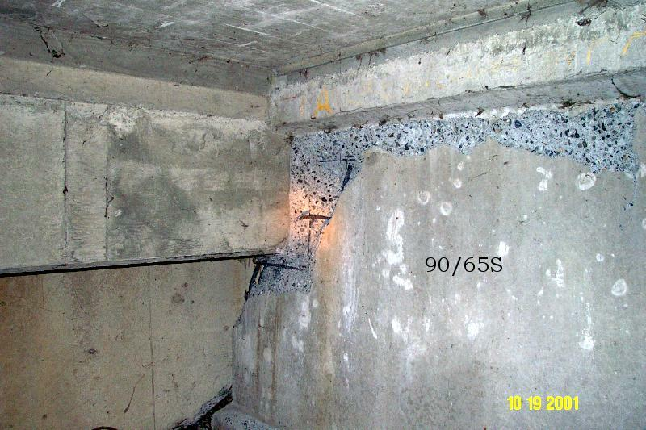
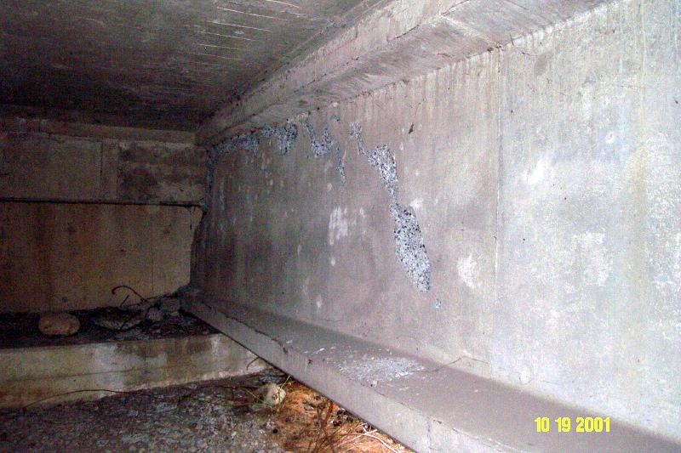
7. Girders (cont’d)
Concrete Girder
Minor Spalling of Concrete

Slide 6
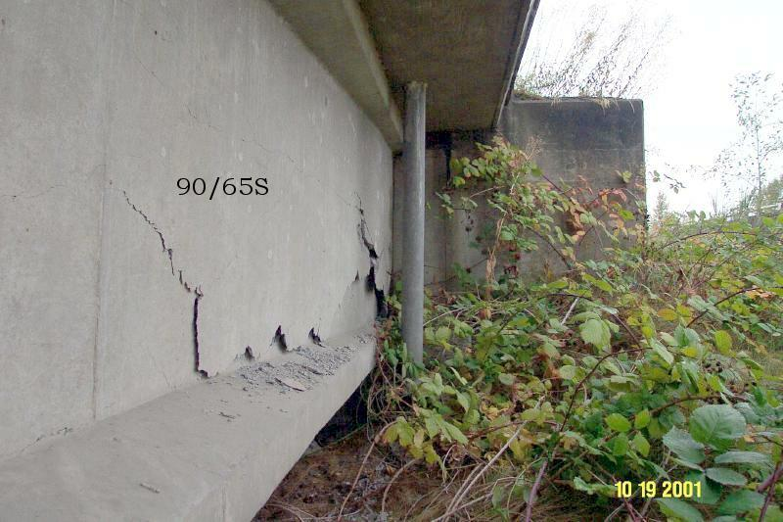
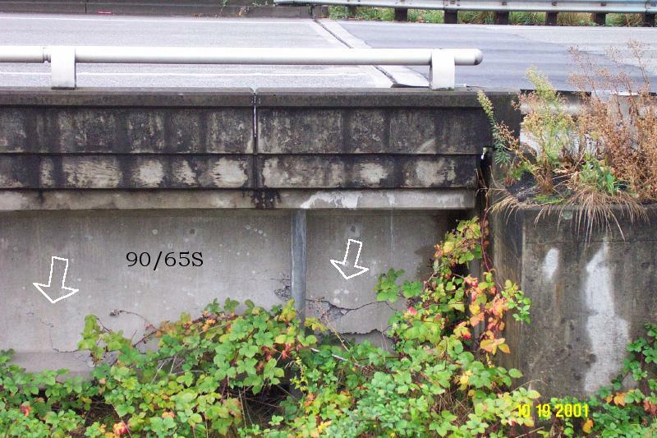
7. Girders (cont’d)
Concrete Girder
Full Depth Web Cracks

Slide 7
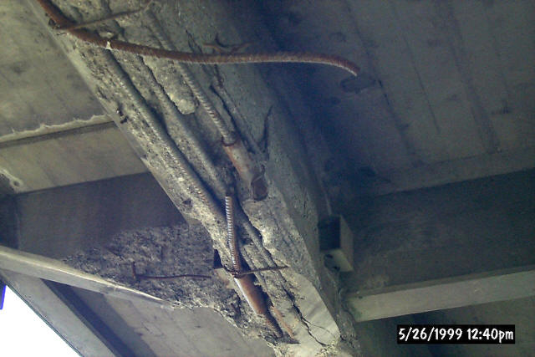
7. Girders (cont’d)
Concrete Girder
Bottom Flange Spalling with Rebar Fracture
Notes:
This is 2nd Ave in Mount Vernon 5/709.
This bridge gets hit a lot. Note the couplers from previous repairs. Weight restrictions have been put on this bridge in the past.
This bridge is now history.

Slide 8
7. Girders (cont’d)
Steel Girder
Minor Paint Flaking
Notes:
Missing rivet?

Slide 9
7. Girders (cont’d)
Steel Girder
Anchor Bolt Damage

Slide 10
7. Girders (cont’d)
Steel Girder
Bearing Stiffener Buckling

Slide 11
7. Girders (cont’d)
Straight Steel Girder
Buckled or Fractured Horizontal Crossframe

Slide 12
7. Girders (cont’d)
Steel Girder
Crack in Web
Cracks in Primary Member
Notes:
What qualifies as a “primary member”?

Slide 13
7. Girders (cont’d)
Horizontally Curved or Highly Skew
Steel Girder
Horizontal Crossframe Fracture

Slide 14
7. Girders (cont’d)
Steel Girder
Girder Buckling

Slide 15
Exercise
Fill out forms for the last bridge

Slide 16
STATE OF CALIFORNIA
SAFETY ASSESSMENT PROGRAM
BRIDGE
Assessment Report No. _________

Slide 17
Assessment Report # _________

Slide 18
Assessment Report # _____________

Slide 19
8. Deck Soffit (underside)
8. Deck Soffit – cracks missing pieces of concrete, exposed rebar
2.
X
1.
2.
3.
4.
5.
6.
7.
8.

Slide 20
8. Soffit Utilities
Disconnected Electrical Conduit or Water Pipe
Disconnected Gas Pipe or Water Main
Broken Powerline

